Slide 1

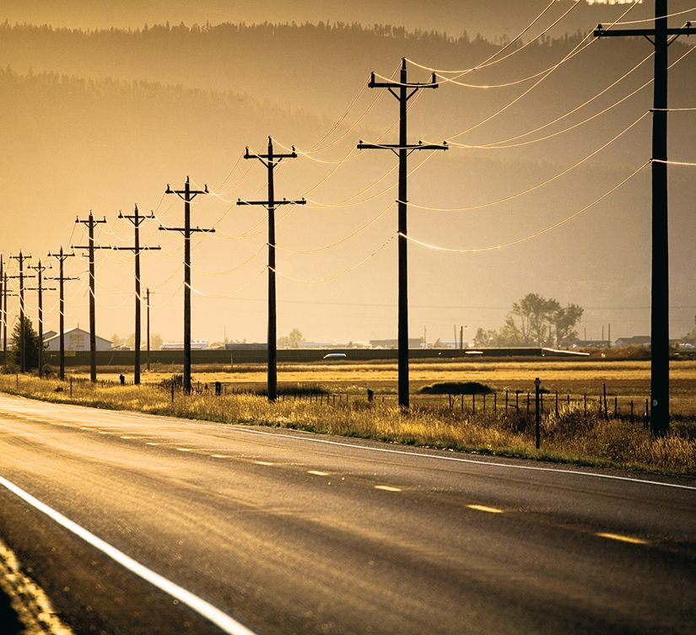
7
Applications of Integration
Copyright © Cengage Learning. All rights reserved.

Slide 2
Area of a Region Between Two Curves
7.1
Copyright © Cengage Learning. All rights reserved.

Slide 3
Objectives
Find the area of a region between two curves using integration.
Find the area of a region between intersecting curves using integration.
Describe integration as an accumulation process.

Slide 4
Area of a Region Between Two Curves

Slide 5
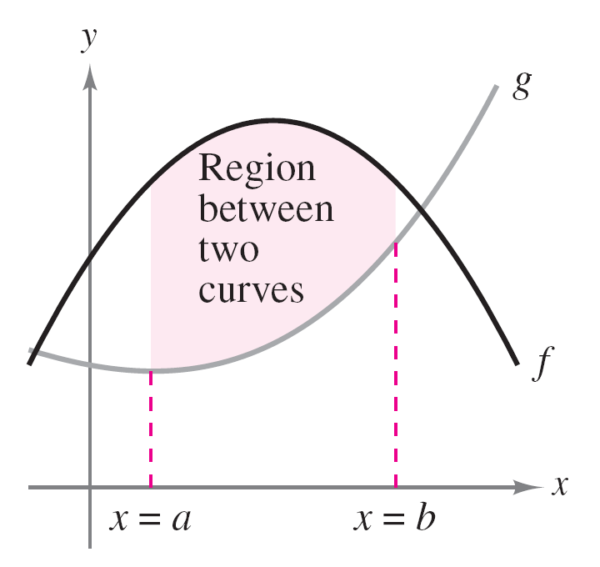
Area of a Region Between Two Curves
With a few modifications, you can extend the application of definite integrals from the area of a region under a curve to the area of a region between two curves.
Consider two functions f and g that are continuous on the interval [a, b].
Figure 7.1

Slide 6
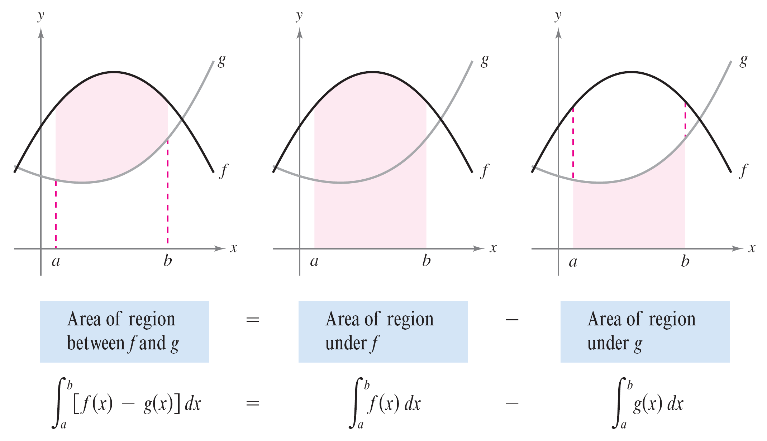
Area of a Region Between Two Curves
If, as in Figure 7.1, the graphs of both f and g lie above the x-axis, and the graph of g lies below the graph of f, you can geometrically interpret the area of the region between the graphs as the area of the region under the graph of g subtracted from the area of the region under the graph of f, as shown in Figure 7.2.
Figure 7.2

Slide 7
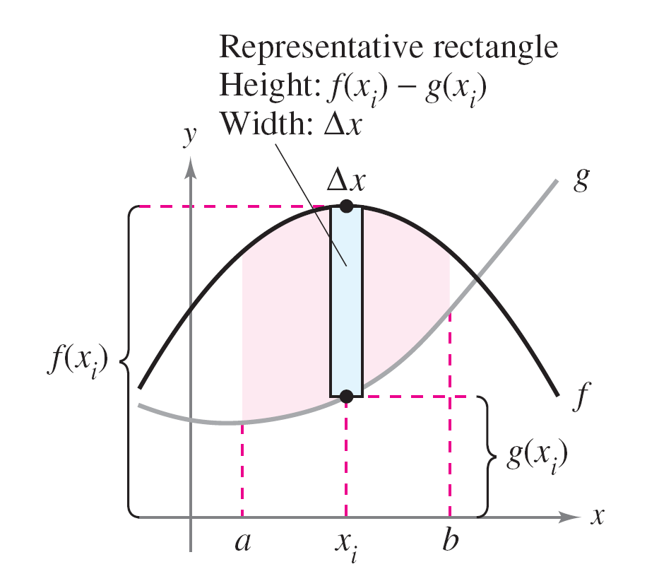
Area of a Region Between Two Curves
To verify the reasonableness of the result shown in Figure 7.2, you can partition the interval [a, b] into n subintervals, each of width Δx.
Then, as shown in Figure 7.3,
sketch a representative rectangle
of width Δx and height f(x_{i}) – g(x_{i}),
where x_{i} is in the ith subinterval.
Figure 7.3

Slide 8
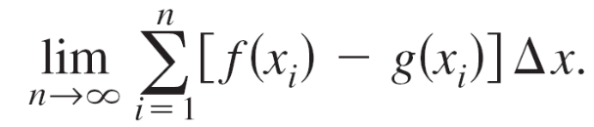
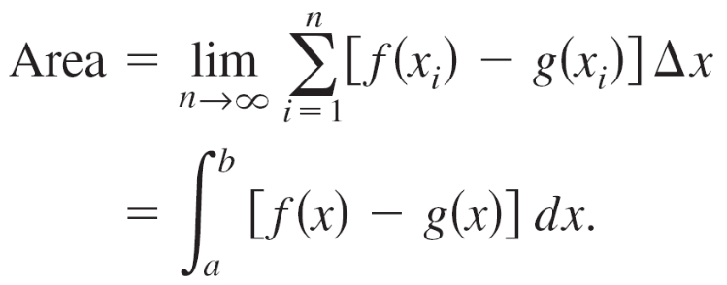
Area of a Region Between Two Curves
The area of this representative rectangle is
ΔA_{i} = (height)(width) = [f(x_{i}) – g(x_{i})]Δx.
By adding the areas of the n rectangles and taking the limit as ||Δ||→0 (n→ ), you obtain
Because f and g are continuous on [a, b], f – g is also continuous on [a, b] and the limit exists. So, the area of the given region is

Slide 9
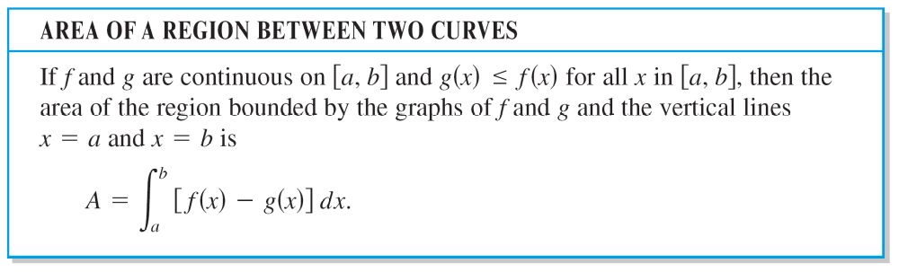
Area of a Region Between Two Curves

Slide 10
Area of a Region Between Two Curves
In Figure 7.1, the graphs of f and g are shown above the x-axis. This, however, is not necessary.
The same integrand [f(x) – g(x)] can be used as long as f and g are continuous and g(x) ≤ f(x) for all x in the interval [a, b].
Figure 7.1

Slide 11
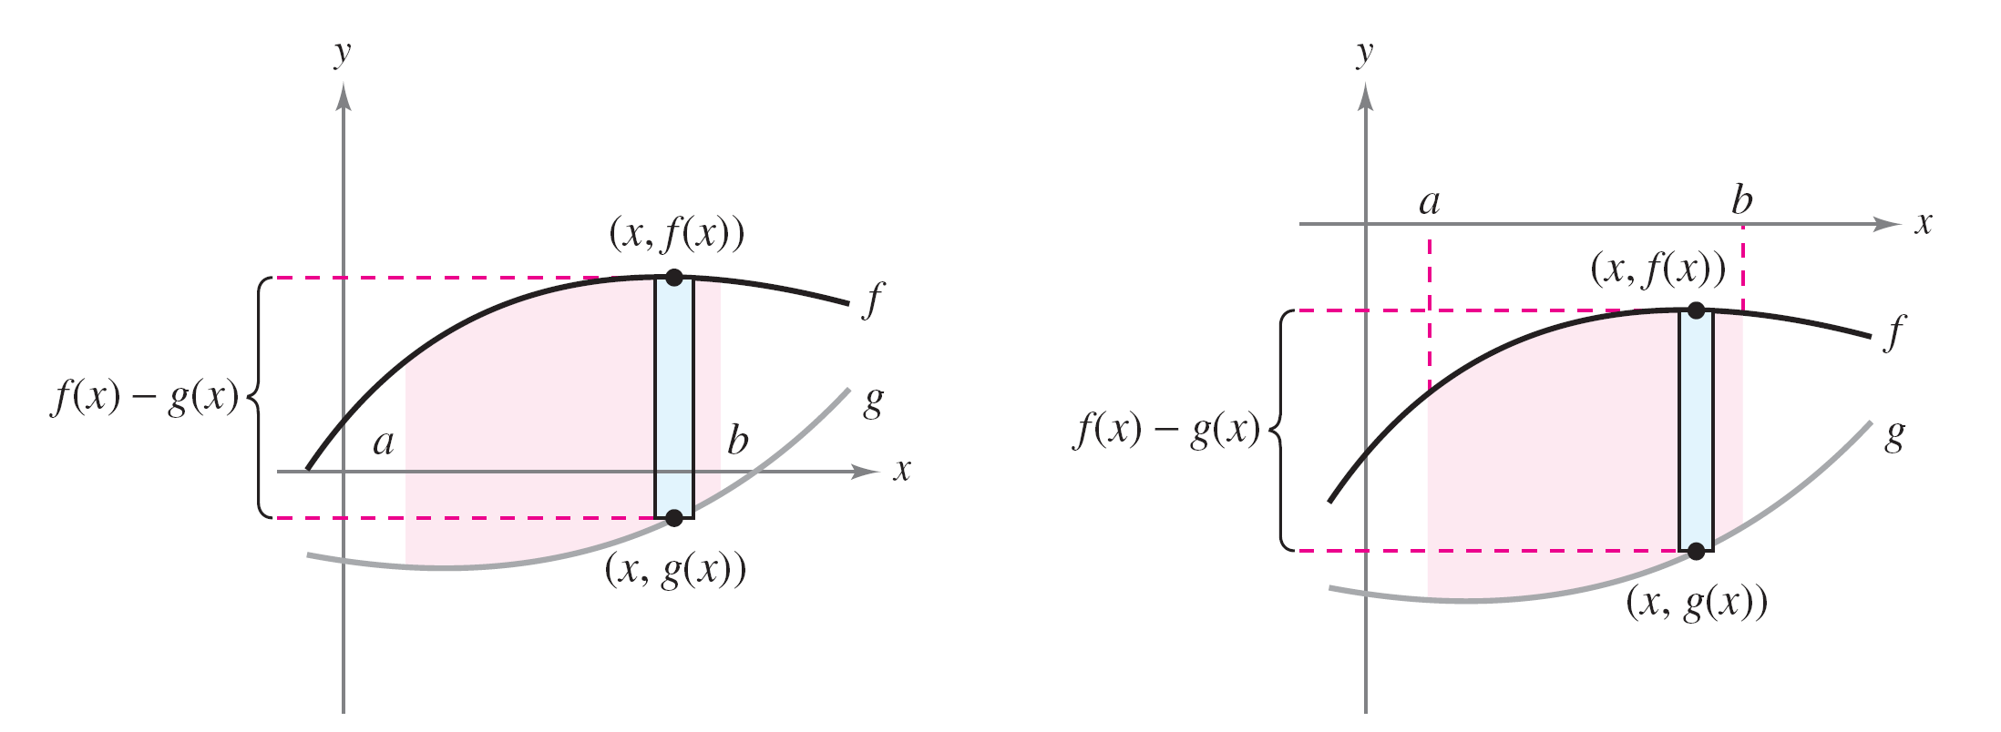
Area of a Region Between Two Curves
This is summarized graphically in Figure 7.4.
Notice in Figure 7.4 that the height of a representative rectangle is f(x) – g(x) regardless of the relative position of the x-axis.
Figure 7.4

Slide 12
Area of a Region Between Two Curves
Representative rectangles are used throughout this chapter in various applications of integration.
A vertical rectangle (of width Δx) implies integration with respect to x, whereas a horizontal rectangle (of width Δy) implies integration with respect to y.

Slide 13
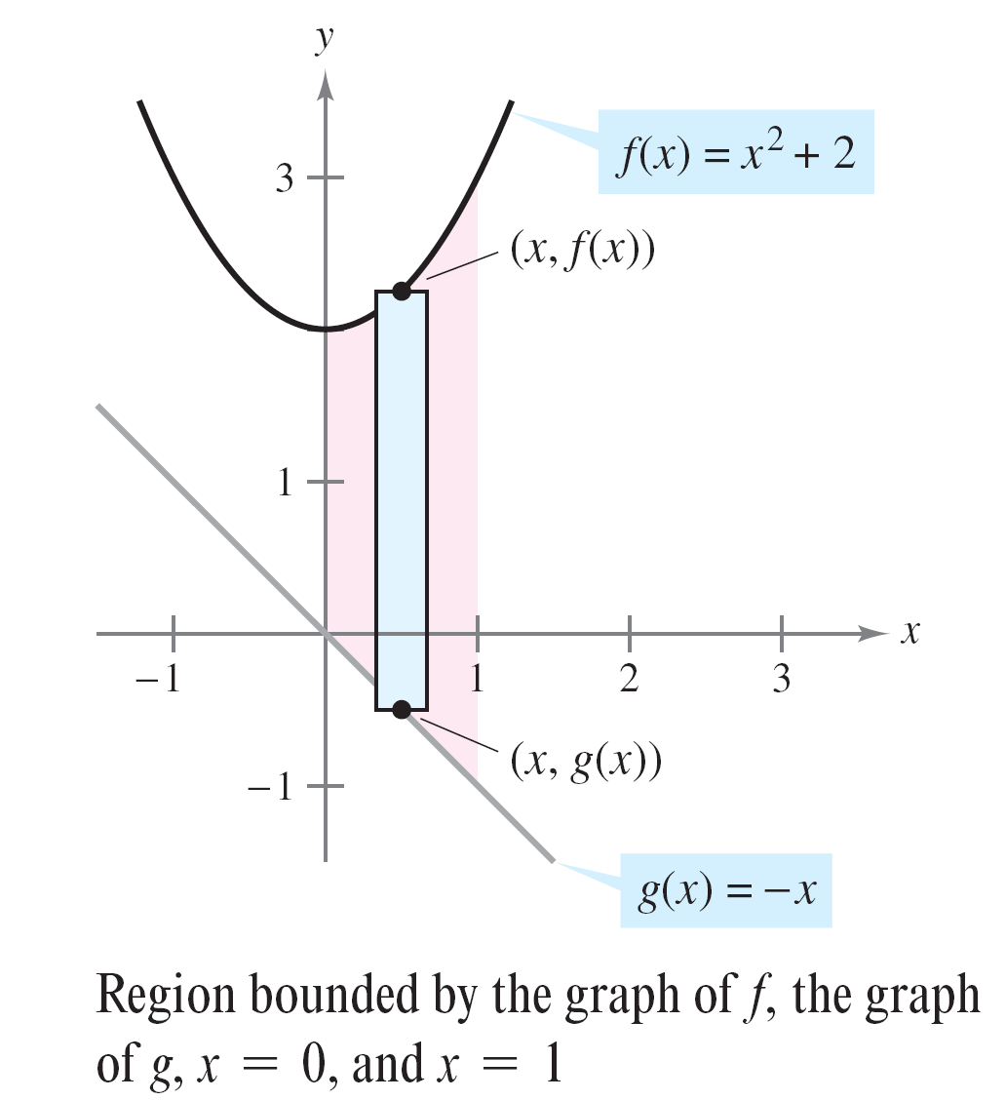
Example 1 – Finding the Area of a Region Between Two Curves
Find the area of the region bounded by the graphs of
f(x) = x² + 2, g(x) = –x, x = 0, and x = 1.
Solution:
Let g(x) = –x and f(x) = x² + 2.
Then g(x) ≤ f(x) for all x in [0, 1],
as shown in Figure 7.5.
Figure 7.5

Slide 14
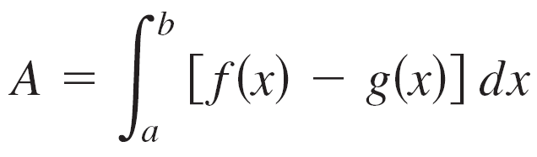
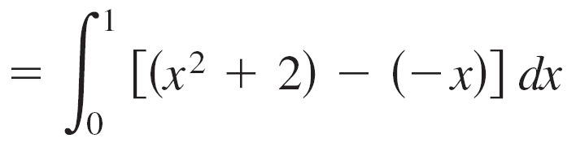
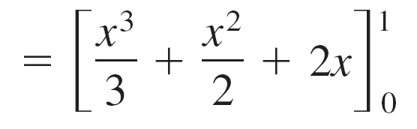
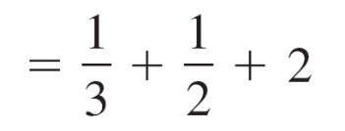
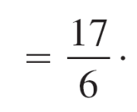
Example 1 – Solution
cont’d
So, the area of the representative rectangle is
ΔA = [f(x) – g(x)]Δx
= [(x² + 2) – (–x)]Δx
and the area of the region is

Slide 15
Area of a Region Between Intersecting Curves

Slide 16
Area of a Region Between Intersecting Curves
In Example 1, the graphs of f(x) = x² + 2 and g(x) = –x do not intersect, and the values of a and b are given explicitly.
A more common problem involves the area of a region bounded by two intersecting graphs, where the values of a and b must be calculated.

Slide 17
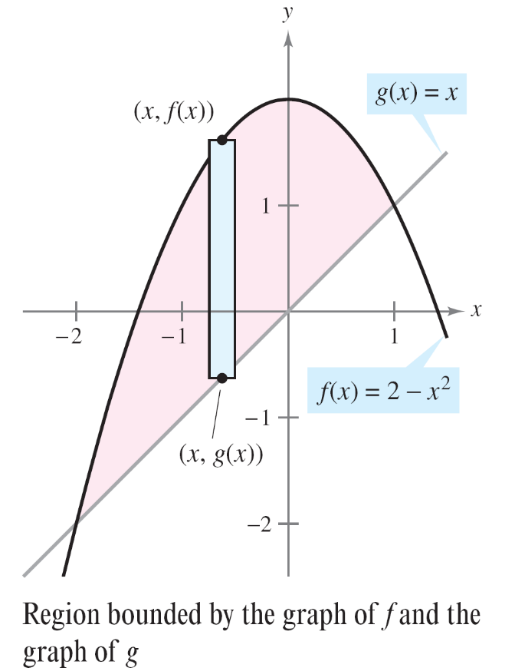
Example 2 – A Region Lying Between Two Intersecting Graphs
Find the area of the region bounded by the graphs of
f(x) = 2 – x² and g(x) = x.
Solution:
In Figure 7.6, notice that the
graphs of f and g have two
points of intersection.
Figure 7.6

Slide 18
Example 2 – Solution
cont’d
To find the x-coordinates of these points, set f(x) and g(x) equal to each other and solve for x.
2 – x² = x Set f(x) equal to g(x)
–x² – x + 2 = 0 Write in general form.
–(x + 2)(x – 1) = 0 Factor
x = –2 or 1 Solve for x.
So, a = –2 and b = 1.

Slide 19
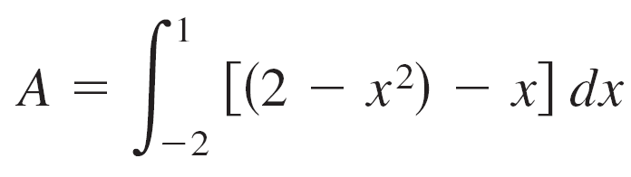
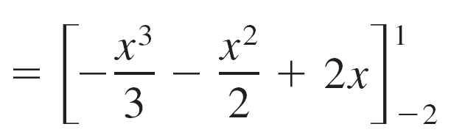
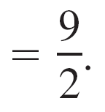
Example 2 – Solution
cont’d
Because g(x) ≤ f(x) for all x in the interval [–2, 1], the representative rectangle has an area of
ΔA = [f(x) – g(x)]Δx
= [(2 – x²) – x]Δx
and the area of the region is

Slide 20
Integration as an Accumulation Process

Slide 21
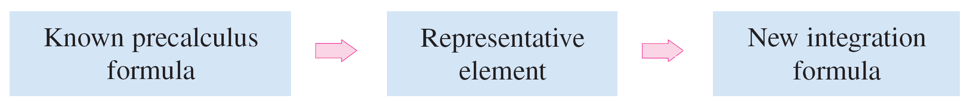
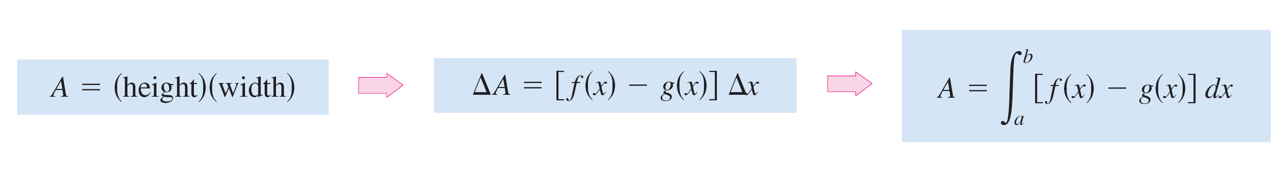
Integration as an Accumulation Process
The integration formula for the area between two curves was developed by using a rectangle as the representative element. Each integration formula will then be obtained by summing or accumulating these representative elements.
For example, the area formula in this section was developed as follows.

Slide 22
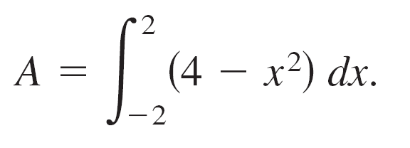
Example 6 – Describing Integration as an Accumulation Process
Find the area of the region bounded by the graph of y = 4 – x² and the x-axis. Describe the integration as an accumulation process.
Solution:
The area of the region is given by
You can think of the integration as an accumulation of the areas of the rectangles formed as the representative rectangle slides from x = –2 to x = 2, as shown in Figure 7.11.

Slide 23
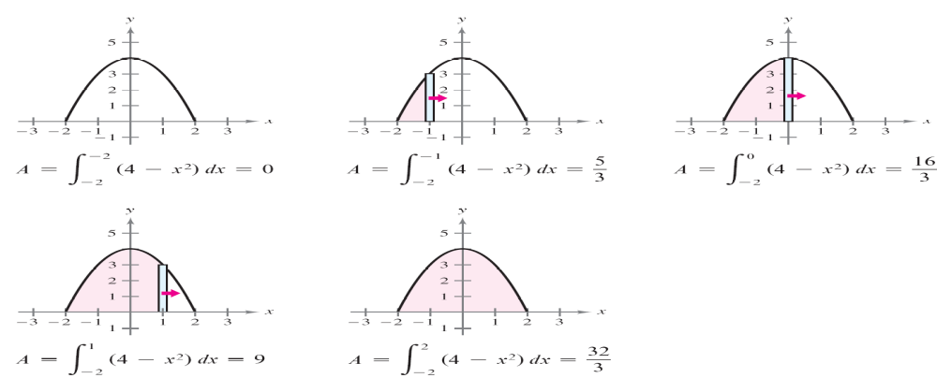
Example 6 – Solution
cont’d
Figure 7.11

